Slide 1

CHAMPIONS
LEAGUE

Slide 2
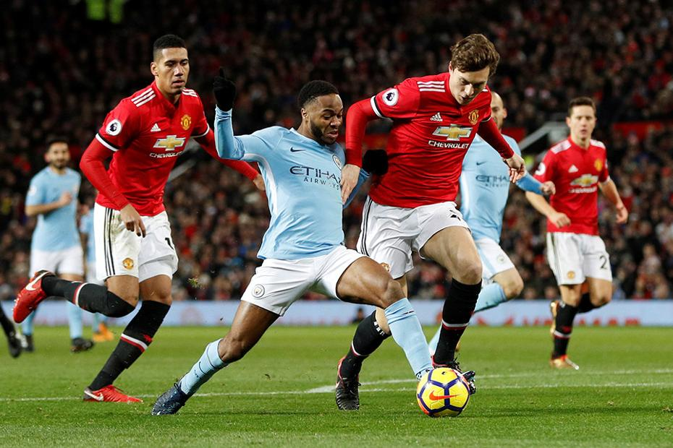

CHAMPIONS LEAGUE
The UEFA Champions League is an annual club football competition organized by the Union of European Football Associations (UEFA). It is one of the most prestigious club competitions in the world and is open to the champion clubs of all UEFA member associations.
Notes:
Hi everyone, welcome to my final Project presentation. I am going to take you through it and hope you enjoy as much as I did.

Slide 3











TEAM LOCATIONS
Some of the countries that regularly have teams participating in the Champions League include:
Spain :
Barcelona, Real Madrid, and Atletico Madrid
England :
Manchester United, Liverpool, and Chelsea
Italy :
Juventus, AC Milan, and Inter Milan
Germany :
Bayern Munich, Borussia Dortmund, and RB Leipzig
France :
Paris Saint-Germain, Olympique Marseille, and AS Monaco

Slide 4
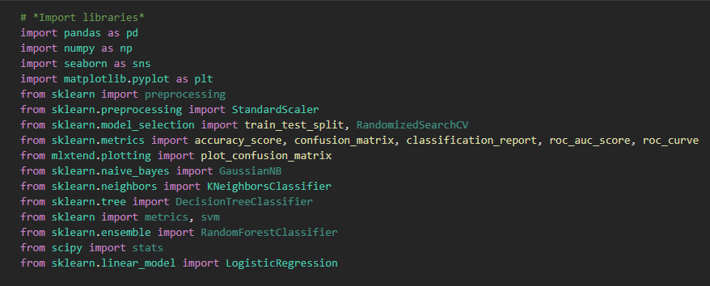
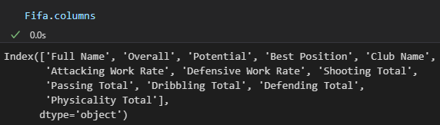
Libraries and Dataset
Notes:
I started of importing the libraries and the dataset gathered from Kaggle and it was about FIFA (the videogame) having features about players on this season. Even though the dataset contained many features, I ended up picking those few, at the bottom

Slide 5
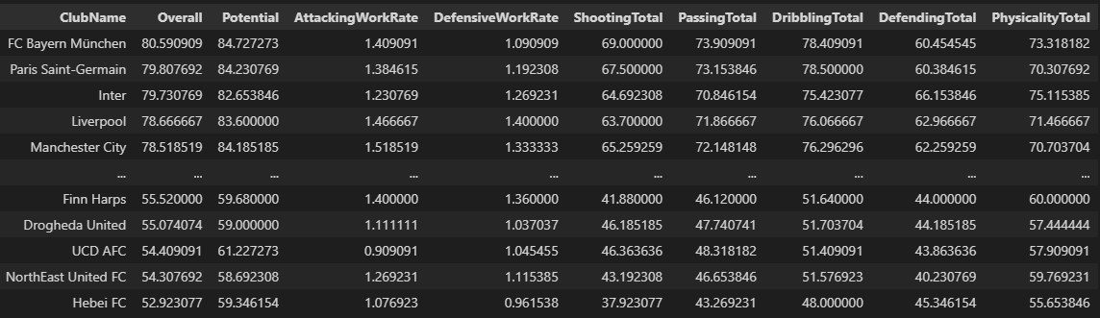
Data Preprocessing
- Data cleaning & Data manipulation
Notes:
I made sure all categorical features didn’t have NULLs or special characters, like some Club names had, so I had to cope with this problema, as Excel was storing names with funny characters.
Also, Data manipulation like encoding some of the categorical features into numbers, or extra features selection process as well as playing with the granularity of the dataset as I switched from player level to club level by grouping the dataset and getting the means of the features as seen in the snapshot

Slide 6
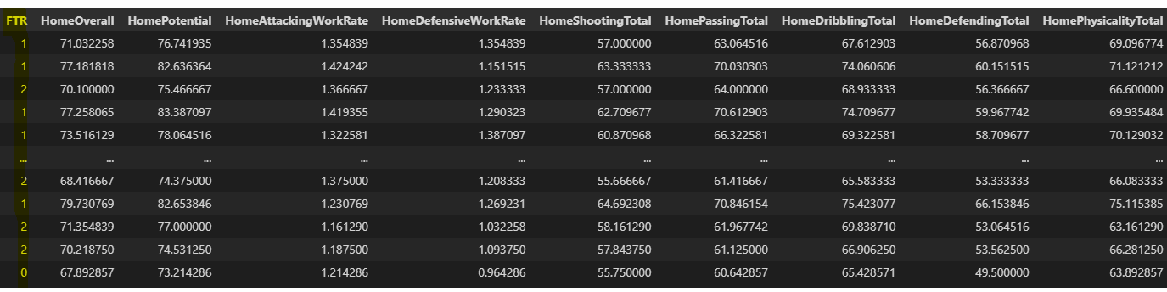
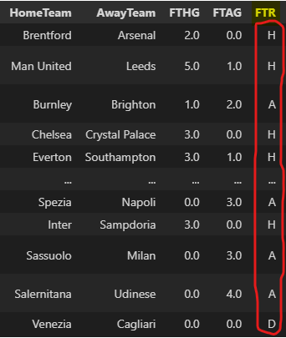
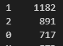
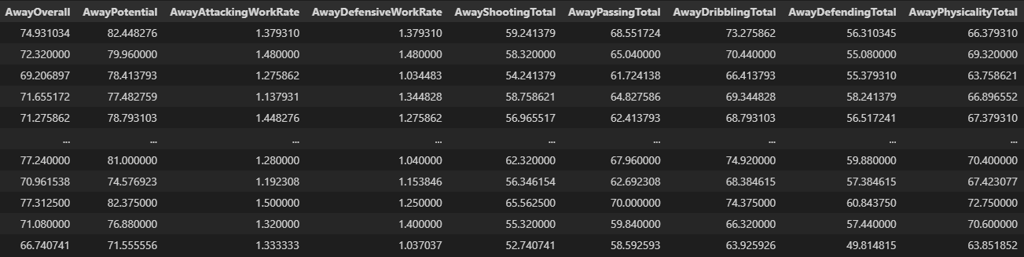
Importing another Datasets
Balanced Dataset
Notes:
I imported other Datasets about match results from last season leagues to join my main FIFA dataset with, in order to train my model, which contains the target column (FTR = Full Time Result), being H = Home Team wins, A = Away Team wins, D = Draw, which later got encoded to have 1, 2 and 0 respectively
Then, the problem I had to tackle here was that club names were spelt differently. Then I had to do a fuzzy look up with Excel to find their corresponding club names matches. Once that was solved, I then could bring my FIFA features and the table looked like:
We can see there that I had to sort of duplicate the FIFA features into Home and Away, to attribute them to each club in a match (point to the Home and Away features)
Finally, I checked out whether the dataset was balanced and I could assume this was the case.

Slide 7
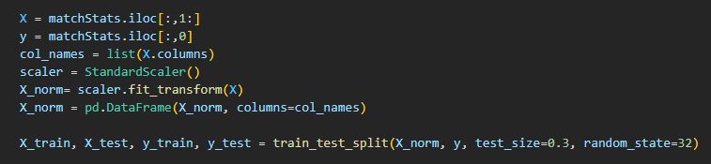
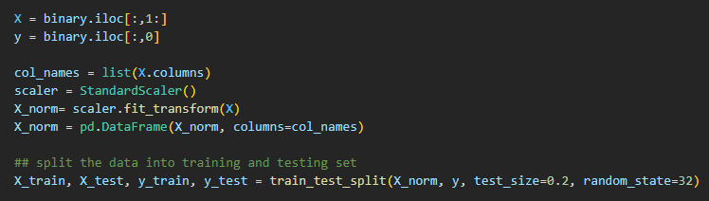
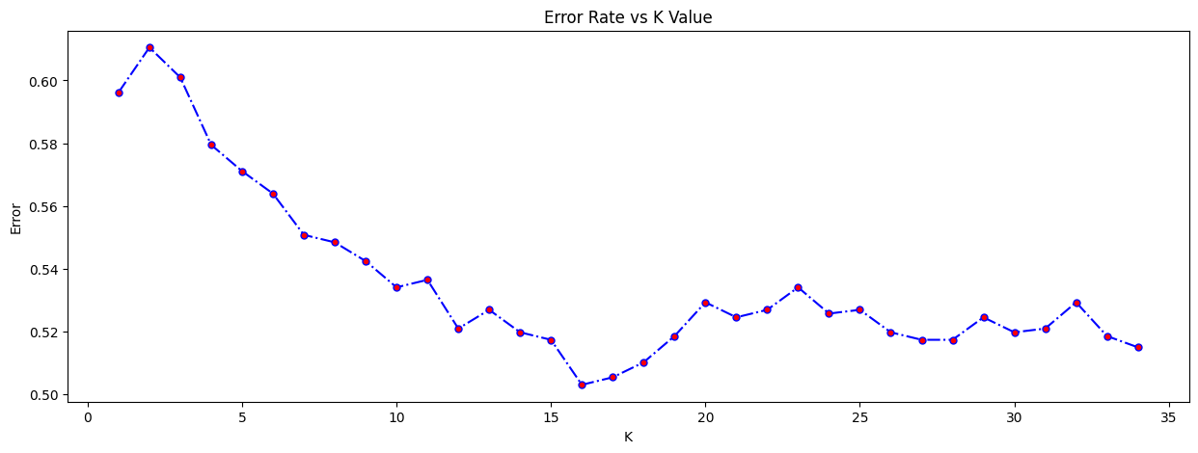
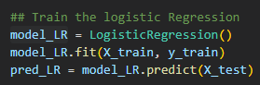
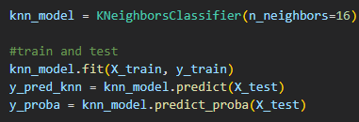
Machine Learning
Group (Multi-Class Classification) - KNN
Knock-out (Binary Classification) - LR
Notes:
In regard to Machine learning, I had to apply 2 models to find out what club would win the Champions League. The first one would be applied in the Group stage and would consist of a multi-class Classification problem because I had to deal 3 classes – Win, Loss or Draw. Then, I split the data in X, the predictors, and Y, the target, and then I normalised the X and chose 30% test size. I picked KNN, and to find out the best number of neighbours I plotted a chart with the error, which is basically those predictions different from reality, therefore, the lowest the error the better. Thus, I picked up K = 16.
As for the second model, I encountered a binary classification problem because I just had to deal with 2 classes, either Win or Loss. So I picked a Logistic Regression model with 20% test size.

Slide 8
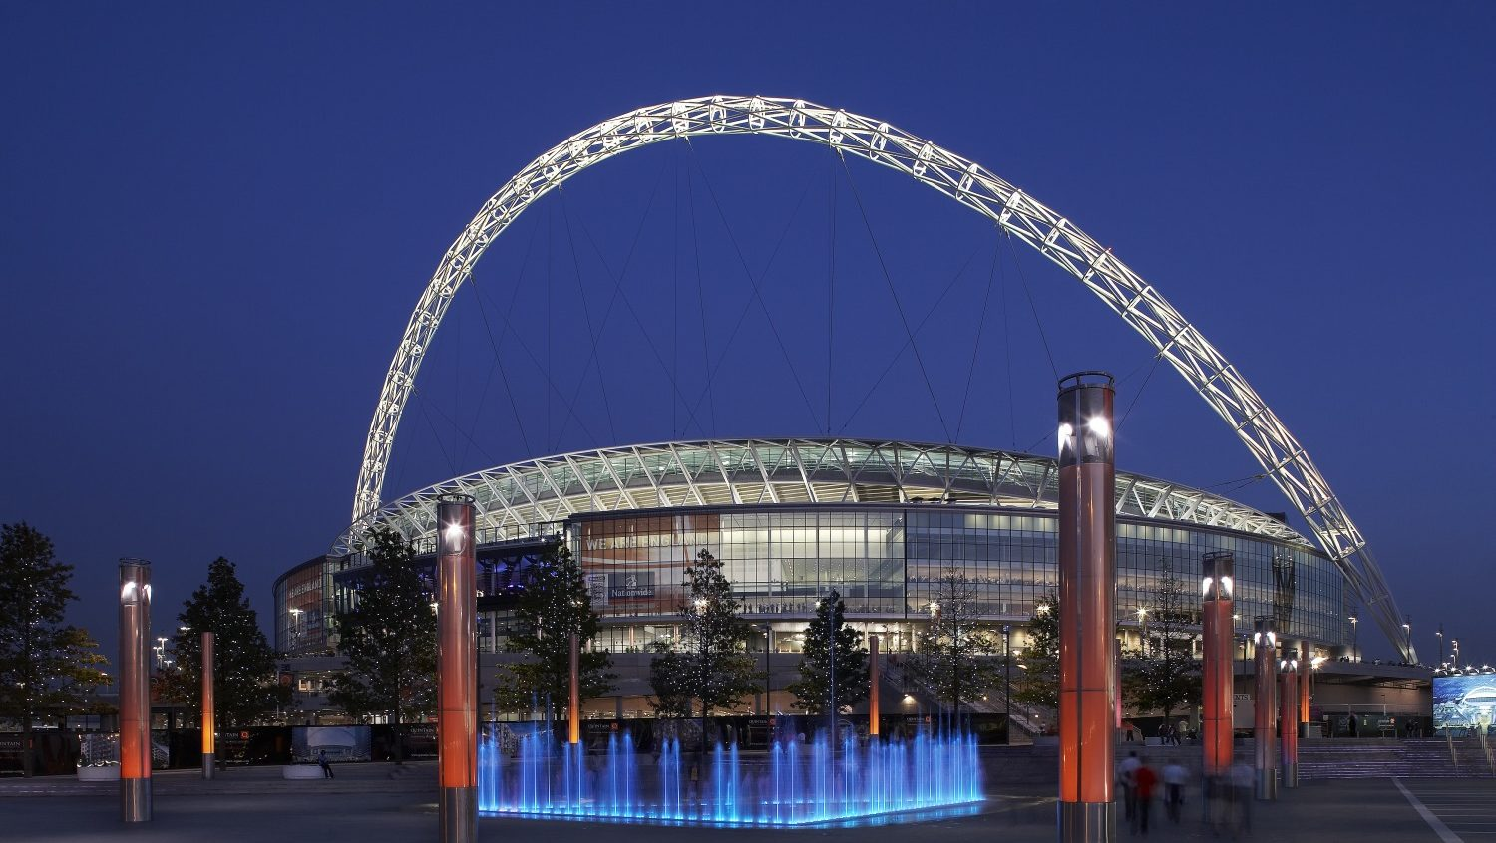
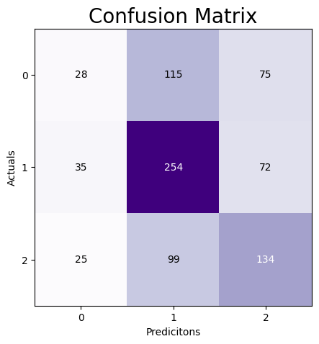
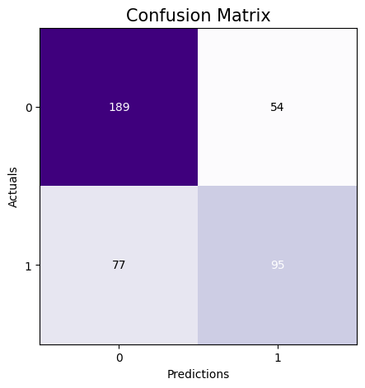
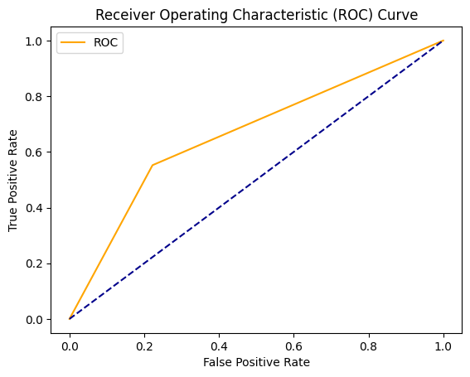
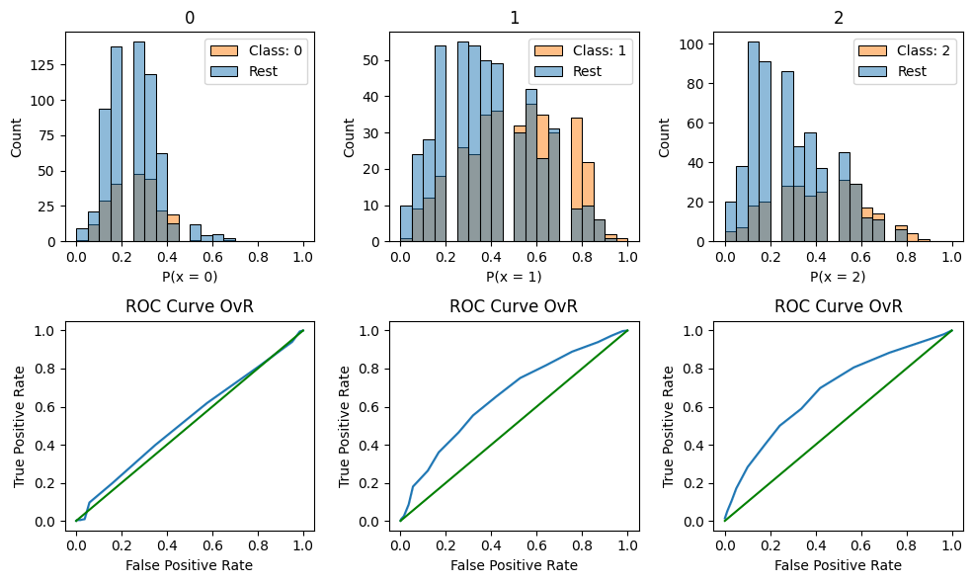
Evaluation Metrics
Group (Multi-Class Classification) - KNN
Knock-out (Binary Classification) - LR
 | Precision | Recall | F1-score
0 | 0.32 | 0.13 | 0.18
1 | 0.54 | 0.70 | 0.61
2 | 0.48 | 0.52 | 0.50
accuracy |  |  | 0.50
 | Precision | Recall | F1-score
0 | 071 | 0.78 | 0.74
1 | 0.64 | 0.55 | 0.59
accuracy |  |  | 0.68
AUC | 0.665052
Notes:
When it comes to Evaluation Metrics As football is a topic quite challenging and hard to predict because there are too many factors that can intervene in the final outcome, as well as I had to use feature means instead of raw data per match because I am wanting to predict future football matches and not already played ones, then the evaluation metrics of the KNN in groups were so so, even though I spent quite a while to optimise it by feature engeneering and picking the best hyperparameters. Then I got about 50% accuracy and I managed to plot a ROC curve somehow for each class compared to the rest.
However, for the Logistic Regression model, the metrics give somthing we can rely more on, as the accuracy is about 70% and the AUC about 67%.

Slide 9
Real application
Streamlit App
Notes:
I am not intending to spend much time explaining what the real application is on the PowerPoint slide, it´s better to switch over to the app I’ve built to see the fun part.

Slide 10
THANKS

